Slide 1
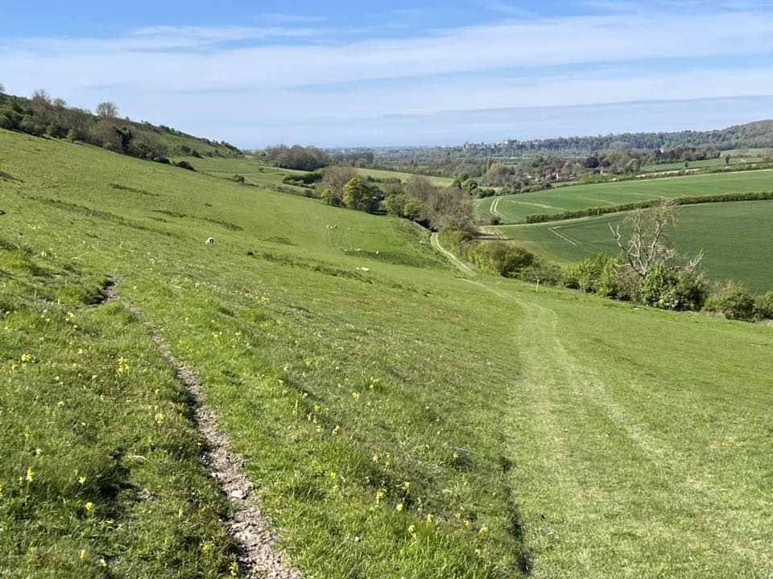

‘The West Wing’ Learning and Development Team Presents:
Lodge of Instruction
Lesson 1.
The Ceremony of Installation.
Notes:
Brethren, the West Wing Learning and Development Team have put together a series of lessons that can be given at a Lodge of Instruction evening.
The Lessons come in three formats:
Audio analysis. (Tell)
Power Point Presentation. (Show)
Discussion Document. (Involve)

Slide 2
Aims
Examine
Examine the Lodge of Instruction
Explain
Explain the Ceremony of Installation.
Examine
Examine the three addresses.
Notes:
Lesson 1
Examine the Lodge of Instruction.
Explain the Ceremony of Installation.
Examine the three addresses.

Slide 3
Objectives
At the end of this lesson the student will be able to discuss:
the purpose and teaching method of a Lodge of Instruction
the ceremony of Installation – The Foundation of Leadership
the three Addresses – The Pillars of a Well Governed Lodge.
Notes:
At the end of this lesson the student will be able to discuss:
the purpose and teaching method of a Lodge of Instruction.
the ceremony of Installation – The Foundation of Leadership.
the Three Addresses – The Pillars of a Well Governed Lodge.

Slide 4
Part 1
Lodge of Instruction.

Slide 5
Lodge of Instruction
The Purpose of a Lodge of Instruction is to teach a man to be a Freemason.
So, what is the purpose of Freemasonry?
Notes:
The purpose of a Lodge of Instruction is not merely to rehearse the ritual, but also to holistically teach a man the multifaceted nature of being a Freemason.

Slide 6

Freemasonry.
The purpose of Freemasonry is to ‘instruct’.
(William Preston)
Notes:
The Core Purpose of Freemasonry: The fundamental aim of Freemasonry is to instruct its members not only on the performance of the ritual but also on what ritual means, the values of civilised society and reflect on personal growth.

Slide 7
Freemason
A Man to whom the burdened heart may pour forth their sorry,
To whom the distressed may prefer their suit,
Whose hand is guided by justice and,
Whose heart is expanded by benevolence.
He is a man who strives to be better man today than he was yesterday.
Notes:
In the address to the Master, it states that a Freemason is:
One to whom the burdened heart may pour fourth his sorrows
To whom the distressed may prefer their suit.
Whose hand is guided by justice.
Whose heart is expanded by benevolence.
He is also a man who strives at a daily advancement in Masonic knowledge.

Slide 8
How is Freemasonry Taught?
By examining the ritual and symbolism applying the findings to daily life
Notes:
The Method of Masonic Instruction: Freemasonry imparts its teachings through the careful examination of ritual and symbolism, with the goal of applying these lessons to everyday life.

Slide 9
Learning Principles
Tell
Tell me I will forget.
Show
Show me I will remember.
Involve
Involve me I will understand.
Notes:
Masonic ritual itself acknowledges these learning principles. To retain its members those members need to be educated and stimulated. This is achieved by involving the membership in every aspect of learning, whether that be by giving them pieces of ritual to recite in Lodge or by discussing the meaning of the ritual and how it applies to a 21st Century Freemason, making Freemasonry relevant. Question the “why” behind our traditions.

Slide 10
A Lodge of Instruction is NOT just a place of rehearsal.
It MUST have an element of analysing, and an understanding of the ritual and symbolism, if it is to fulfill its role of teaching a man to be a Freemason.
Notes:
We must connect the symbolism and allegories within our ritual to the challenges and opportunities of our daily lives. Share examples of lessons learnt and how Lodge of Instruction has influenced our actions as men, partners, colleagues and citizens.

Slide 11
Example LoI Program.
LoI 1. Discuss the ceremony of Installation and the 3 Addresses.
LoI 2. Identify and explain the role of each Lodge Officer.
LoI 3. A walk around the Lodge.
LoI 4. Examine entrusting and obligation.
LoI 5. Examine the North East Corner address.
LoI 6. Analyse the 1st Degree Working Tools.
LoI 7. Examine the Charge after Initiation.
LoI 8. Analyse and explain the First-Degree Tracing Board.
Notes:
This series will touch on each of these topics to bring our ritual to life.

Slide 12
Part 2
The Ceremony of Installation.

Slide 13
Lesson Objectives
At the end of this lesson the student will be able to:
To explain the purpose and procedure of the Ceremony of Installation.
To examine the meaning and significance of the three traditional addresses delivered during the ceremony.
Notes:
In this first lesson we are looking at explaining the purpose and procedure of the Ceremony of Installation and examining the meaning and significance of the three traditional addresses delivered through the ceremony.

Slide 14
The Annual Election of the Master.
Key Point:
Every Lodge must annually elect a WM.
Authority:
Rule 105 B of C.
Notes:
According to Rule 105 of the Book of Constitutions every Lodge shall annually ballot for a qualified Brother to serve as Master for the ensuing year. At the next Regular meeting, after the ballot, the Master elect will be installed into the Masters Chair.
How do you qualify to be considered as a prospective Master?
Rule 105 of the Book of Constitution states that a prospective Master must have served as Master or Warden in a Regular Lodge for a period of 12 months.

Slide 15
The Annual Election of the Master.
Process:-
1. Ballot
2. Formally Installed
Notes:
According to Rule 105 of the Book of Constitutions every Lodge shall annually ballot for a qualified Brother to serve as Master for the ensuing year. At the next Regular meeting, after the ballot, the Master elect will be installed into the Masters Chair.

Slide 16
The Master’s Commitment.
Before Installation, the Master Elect Must:-
Give unqualified assent to ancient Charges.
Take a solemn Obligation to the faithful discharge of his responsibilities.
Notes:
According to the ritual of the Second Degree, the Master Elect must give his unqualified assent to several Ancient Charges relating to his conduct and take a solemn obligation. The Lodge is then opened in the Third Degree, and the Master elect is then presented to a Board of Installed Masters to receive from his predecessor the benefit of installation.

Slide 17
The Board of Installed Masters.
presented to a Board of Installed Masters.
benefit of Installation by predecessor.
Placed into the Chair of King Solomon.
HIGHEST HONOUR
Notes:
A board of Installed Masters is very selective and secretive as the Master elect joins the ranks of established teachers of the ‘Craft’. To join their number, you must have proved yourself worthy of such an accolade.

Slide 18
The Board of Installed Masters.
presented to a Board of Installed Masters.
benefit of Installation by predecessor.
Placed into the Chair of King Solomon.
HIGHEST HONOUR
Notes:
This unique ceremony known as the ‘Inner Workings’, is conducted, usually, by the outgoing Master and is very poignant and personal.

Slide 19
The Board of Installed Masters.
presented to a Board of Installed Masters.
benefit of Installation by predecessor.
Placed into the Chair of King Solomon.
HIGHEST HONOUR
Notes:
The new Master is placed into the Chair of King Solomon which represents Wisdom. The wisdom of Solomon at work illuminates the virtues of faith, courage, compassion, integrity and justice. It shows how spiritual wisdom can be woven into the fabric of everyday life, informing and improving everything we do.

Slide 20
The Board of Installed Masters.
presented to a Board of Installed Masters.
Receives the benefit of Installation by predecessor.
HIGHEST HONOUR
PLACED INTO THE CHAIR OF KING SOLOMON
Notes:
To be place into the Chair of King Solomon is the highest honour a Lodge can bestow on any of its members.

Slide 21
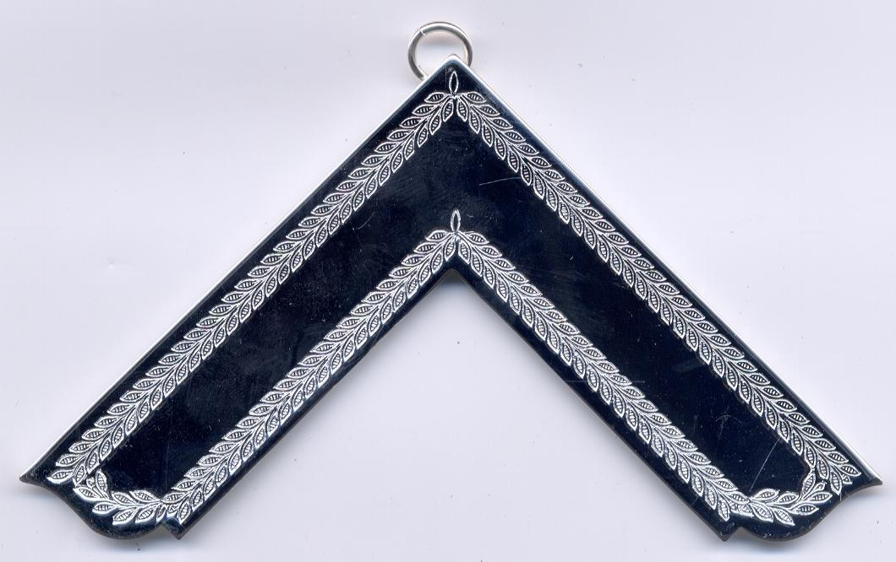
The Master’s Jewel.
The Square is a test of perfection.
Symbolically used to test the Brethren to plan instruction.
Purpose of Freemasonry is “to Instruct.”
Notes:
He is presented with his jewel or badge of office, the Square. An implement which, when placed on an ashlar identifies weaknesses and perfections. Symbolically the Master can then plan lessons for Lodges of Instruction whereby the Brethren can make advances in Masonic knowledge, the knowledge of themselves. For what is the purpose of Freemasonry? According to William Preston “it is to instruct.”

Slide 22
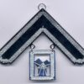
Immediate Past Master’s Jewel
Addition of the 47th Problem of Euclid. Marks progress in life and in Masonry.
01
Euclid’s 47th Problem – Method to prove a right angle
02
Symbolises how the universe can be understood through measurement.
03
Notes:
In the Inner Workings the Immediate Past Master is awarded his jewel of office which is a Square with the addition of a representation of Euclid’s 47th Problem to mark his progress both in life and in Freemasonry as he leaves office.
Euclid’s 47th Problem was to find a simple method of proving a right angle. He did this by establishing a formula which proves a right-angled triangle. (3 squared + 4 square = 5 squared. A 3/4/5 triangle.) By using this theorem, also known as the Pythagoras Theorem, man was able to accurately build, measure distances, calculate positions, in short ‘measure things.’ The 47th Problem of Euclid helps us look at the Universe through a measurable system which is understandable and is well applied to Freemasons as a guide to their actions.

Slide 23
Proclamation and Appointment.
LODGE RESUMED IN 3RD DEGREE
PROCLAMATION AND SALUTATION IN EACH DEGREE.
APPOINTS TEAM
Notes:
After the ‘Inner Working’ ceremony the Lodge is resumed in the third degree.

Slide 24
Proclamation and Appointment.
LODGE RESUMED IN 3RD DEGREE.
PROCLAMATION AND SALUTATION IN EACH DEGREE.
APPOINT TEAM
Notes:
All Masons are admitted as the Lodge is reopened in each degree. In each degree there is a a proclamation, salutation to the new Worshipful Master in recognition of his new status.

Slide 25
Proclamation and Appointment.
LODGE RESUMED IN 3RD DEGREE
PROCLAMATION AND SALUTATION IN EACH DEGREE
APPOINT TEAM
Notes:
The Worshipful Master then appoints his team for the year and explains to each team member their duties so that they are in no doubt of their role in supporting him and the Lodge.

Slide 26
Three Addresses: A Charge for All.
Delivered by 3 Lodge Elders.
Outlines the duties and expectations of the WM, Wardens & Brethren
Notes:
The final part of the installation ceremony is the addresses by three ‘elders’ of the Lodge, to the Master, his Wardens and the Brethren, as to what is expected of them.

Slide 27


ADDRESS TO THE WORSHIPFUL MASTER
“As a pattern for imitation consider that great luminary of nature…………
Key
Exhortation:
Notes:
The key words of advice from the elder delivering the address to the Master is:
“As a pattern for imitation consider that great luminary of nature, which, rising in the East diffuse light and lustre to all within its circle, in like manner it is your peculiar province to communicate light and instruction to the Brethren of your Lodge.”

Slide 28





ADDRESS TO THE WORSHIPFUL MASTER
CORE RESPONSIBILITIES
UPHOLD THE HONOUR REPUTATION AND USEFULNESS
IMPRESS DIGNITY OF MASONRY
PROMOTE HAPPINESS
GOVERN ACCORDING TO LAW
Notes:
Core responsibility:
1. Uphold the honour, reputation and usefulness of the Lodge.

Slide 29


ADDRESS TO THE WORSHIPFUL MASTER
CORE RESPONSIBILITIES
UPHOLD THE HONOUR REPUTATION AND USEFULNESS
IMPRESS DIGNITY OF MASONRY
PROMOTE HAPPINESS
GOVERN ACCORDING TO LAW
Notes:
Core responsibility:
2. Impress on the Brethren the dignity and high importance of Masonry.

Slide 30

ADDRESS TO THE WORSHIPFUL MASTER
CORE RESPONSIBILITIES
UPHOLD THE HONOUR REPUTATION AND USEFULNESS
IMPRESS DIGNITY OF MASONRY
PROMOTE HAPPINESS
GOVERN ACCORDING TO LAW
Notes:
Core responsibility:
3. By virtuous, amiable and discreet conduct prove to the world the happy and beneficial effects of our Ancient Institution.

Slide 31

ADDRESS TO THE WORSHIPFUL MASTER
CORE RESPONSIBILITIES
UPHOLD THE HONOUR REPUTATION AND USEFULNESS
IMPRESS DIGNITY OF MASONRY
PROMOTE HAPPINESS
GOVERN ACCORDING TO LAW
Notes:
Core responsibility:
4. Observe the Sacred writings the guide to our faith, the Book of Constitutions and the By-laws of the Lodge as to the conduct as a Master.

Slide 32
Analysis.
A model of Servant Leadership.
A moral Compass.
A Framework of Governance.
Rhetorical Power.
Notes:
The address uses powerful metaphors (the sun), elevated language ("worthy and worshipful," "glorious luminary"), and a clear, structured argument to impress upon the new Master the importance of his role. It appeals to his sense of honour, duty, and responsibility.
It presents a model of servant leadership. The Master is placed in a position of supreme authority within the lodge, yet his purpose is to serve the members by providing instruction, promoting harmony, and ensuring the health of the institution. His success is not measured by personal gain but by the "usefulness" of the Lodge and the "happiness" of its members.

Slide 33
Analysis.
A model of Servant Leadership.
A moral Compass.
A Framework of Governance.
Rhetorical Power.
Notes:
The text is a concise summary of a system of applied morality. It posits that adherence to a set of core principles (taught within the Lodge) will result in a virtuous life that benefits not only the individual but society as a whole.

Slide 34
Analysis.
A model of Servant Leadership.
A moral Compass.
A Framework of Governance.
Rhetorical Power.
Notes:
It clearly defines the hierarchy of rules that ensure order and consistency within a self-governing body, from the local by-laws to the overarching constitutions and foundational sacred texts.

Slide 35
Analysis.
A model of Servant Leadership.
A moral Compass.
A Framework of Governance.
Rhetorical Power.
Notes:
In conclusion, the "Address to the Master" is a masterful charge that combines symbolic exhortation with a clear articulation of duties. It functions as an inauguration speech, a job description, and a moral compass for the leader of a Masonic Lodge, reminding him that his year in the "Chair" is a sacred trust, with his conduct directly shaping the integrity and legacy of the entire system.

Slide 36
Address to the Wardens.
“What you see praiseworthy in others you should carefully imitate…….”
KEY EXHORTATION
Notes:
Key Exhortation:
“…what you observe praiseworthy in others you should carefully imitate, and what in them may appear defective, you should in yourselves amend.

Slide 37




Address to the Wardens.
CORE RESPONSIBILITIES
PERFORMANCE & ATTENDANCE
BE A GOOD EXAMPLE (ROLE MODEL)
ASSIDUOUSLY ASSIST THE WM
COMMUNICATE LIGHT & IMPART KNOWLEDGE
Notes:
Core Responsibilities:
Strict performance of duties and regular attendance.

Slide 38

Address to the Wardens.
CORE RESPONSIBILITIES
STRICT PERFORMANCE OF DUTIES & REGULAR ATTENDANCE
BE A GOOD EXAMPLE (ROLE MODEL)
ASSIDUOUSLY ASSIST THE WM
COMMUNICATE LIGHT & IMPART KNOWLEDGE
Notes:
Role Model – “You ought to be examples of good order and regularity, for it is only by paying due obedience to the laws in our own conduct that we can reasonably expect compliance with them from others.”

Slide 39

Address to the Wardens.
CORE RESPONSIBILITIES
STRICT PERFORMANCE OF DUTIES & REGULAR ATTENDANCE
BE A GOOD EXAMPLE (ROLE MODEL)
ASSIDUOUSLY ASSIST THE WM
COMMUNICATE LIGHT & IMPART KNOWLEDGE
Notes:
Assist the WM in the discharge of his important trust.

Slide 40

Address to the Wardens.
CORE RESPONSIBILITIES
PERFORMANCE & ATTENDANCE
BE A GOOD EXAMPLE (ROLE MODEL)
ASSIDUOUSLY ASSIST THE WM
COMMUNICATE LIGHT & IMPART KNOWLEDGE
Notes:
Assist the WM by communicating ‘Light’ and imparting knowledge to all whom he may place under your direction.

Slide 41
Analysis
A lesson in Middle Management.
A Tool for Leadership Development.
A balance of Trust and Accountability.
A Model of Delegated Responsibility.
Notes:
The text clearly delineates a three-tiered structure: the Worshipful Master (chief executive), the Wardens (principal officers/deputies), and the Brethren (the members). The Wardens' role is to execute the vision of the Master and manage the members under their care.

Slide 42
Analysis
A lesson in Middle Management.
A Tool for Leadership Development.
A balance of Trust and Accountability.
A Model of Delegated Responsibility.
Notes:
The address functions as a tool for leadership development. It charges the Wardens not only to perform tasks but to actively cultivate leadership qualities: self-awareness, discipline, moral consistency, and the ability to instruct others. It serves as a training ground for the eventual responsibility of leading the lodge as Master.

Slide 43
Analysis
A lesson in Middle Management.
A Tool for Leadership Development.
A balance of Trust and Accountability.
A Model of Delegated Responsibility.
Notes:
The address is built on a foundation of trust ("we entertain no doubt") but also demands strict accountability ("pledged...to a strict performance"). It balances empowerment with a clear expectation of responsibility.
The tone is formal and serious, yet also encouraging and respectful. It avoids micromanagement, instead focusing on broad principles of conduct and duty. It empowers the Wardens by assuming their competence while firmly reminding them of the standards they are expected to uphold.

Slide 44
Analysis
A lesson in Middle Management.
A Tool for Leadership Development.
A balance of Trust and Accountability.
A Model of Delegated Responsibility.
Notes:
The address is built on a foundation of trust ("we entertain no doubt") but also demands strict accountability
In summary, the "Address to the Wardens" serves as a formal charge that solidifies their commitment, sets a high standard for their personal behaviour as role models, and clarifies their crucial supportive role in the overall governance and educational mission of the lodge. It is a lesson in responsible, delegated authority

Slide 45

Address to the Brethren
“Humility in each is an essential qualification….”
KEY EXHORTATION:
Notes:
Key Exhortation:
“…the nature in our Constitution that some must of necessity rule and teach, so others must of course learn, submit, and obey. Humility in each is an essential qualification.”

Slide 46





Address to the Brethren
CORE RESPONSIBILITIES
HUMILITY ESSENTIAL QUALIFICATION
NOT ENVY PREFERMENT
BE HAPPY & COMMUNICATE HAPPINESS
FAITHFUL TO GOD, COUNTRY & LAWS
Notes:
Core Principles:
Recognition that some must rule and teach so others must of course learn, submit and obey. Humility in each is an essential qualification.

Slide 47


Address to the Brethren
CORE RESPONSIBILITIES
HUMILITY ESSENTIAL QUALIFICATION
NOT ENVY PREFERMENT
BE HAPPY & COMMUNICATE HAPPINESS
FAITHFUL TO GOD, COUNTRY & LAWS
Notes:
Avoid envy.
Practice Brotherly love.

Slide 48

Address to the Brethren
CORE RESPONSIBILITIES
HUMILITY ESSENTIAL QUALIFICATION
NOT ENVY PREFERMENT
BE HAPPY & COMMUNICATE HAPPINESS
FAITHFUL TO GOD, COUNTRY & LAWS
Notes:
One aim – to be happy and communicate happiness.

Slide 49

Address to the Brethren
CORE RESPONSIBILITIES
HUMILITY ESSENTIAL QUALIFICATION
NOT ENVY PREFERMENT
BE HAPPY & COMMUNICATE HAPPINESS
FAITHFUL TO GOD, COUNTRY & LAWS
Notes:
Learn to be meek, humble and resigned; to be faithful to our God, our Country and our Laws.

Slide 50




UNDERSTANDING CHARGE TO THE BRETHREN
A SOCIAL CONTRACT
A BLUEPRINT FOR CHARACTER EDUCATION
A LESSON IN CIVIC DUTY
A FOUNDATION FOR ORGANISATIONAL CULTURE
Notes:
It is a perfect example of a social contract in microcosm. It explains the need for governance, the responsibilities of both leaders and followers, and the shared goal that makes the structure meaningful. The emphasis on loyalty to God, Country, and Laws is a strong lesson in civic responsibility.

Slide 51


UNDERSTANDING CHARGE TO THE BRETHREN
A SOCIAL CONTRACT
A BLUEPRINT FOR CHARACTER EDUCATION
A LESSON IN CIVIC DUTY
A FOUNDATION FOR ORGANISATIONAL CULTURE
Notes:
The address is a blueprint for moral development. It uses powerful symbolism and metaphor to teach virtues like humility, integrity, self-control, and compassion. It provides a clear cause-and-effect model: if you follow these principles, you will become a better person and a more positive force in the world.
The text is a model of effective persuasive communication. It anticipates potential conflict (envy, resentment of authority) and addresses it proactively. It uses an inclusive and unifying tone ("Brethren," "we") to foster a sense of community and shared identity.

Slide 52

UNDERSTANDING CHARGE TO THE BRETHREN
A SOCIAL CONTRACT
A BLUEPRINT FOR CHARACTER EDUCATION
A LESSON IN CIVIC DUTY
A FOUNDATION FOR ORGANISATIONAL CULTURE
Notes:
The text is a model of effective persuasive communication. It anticipates potential conflict (envy, resentment of authority) and addresses it proactively. It uses an inclusive and unifying tone ("Brethren," "we") to foster a sense of community and shared identity.

Slide 53

UNDERSTANDING CHARGE TO THE BRETHREN
A SOCIAL CONTRACT
A BLUEPRINT FOR CHARACTER EDUCATION
A LESSON IN CIVIC DUTY
A FOUNDATION FOR ORGANISATIONAL CULTURE
Notes:
It demonstrates how to build a strong organizational culture. It establishes clear expectations, defines a shared mission, reinforces core values, and gives every member a meaningful role to play in the collective enterprise.
In conclusion, the "Address to the Brethren" is far more than a simple welcome. It is a foundational document that defines the ideal member of the fraternity. It instructs him on how to behave within the lodge's hierarchy, how to conduct himself as a moral individual, and how to understand his role as a link in a chain that stretches from the past into the future. It masterfully turns the concept of obedience from a command into a willing and humble participation in a grand and noble design.

Slide 54



CONCLUSION: A UNIFIED PURPOSE
SUMMARY
THE CEREMONY OF INSTALLATION ENSURES STABLE AND QUALIFIED LEADERSHIP
THE THREE ADDRESSES CREATE A HARMONIOUS AND EFFECTIVE INSTITUTION
Notes:
The three addresses create a harmonious and effective institution, whilst the Ceremony of Installation ensures stable and qualified leadership.

Slide 55
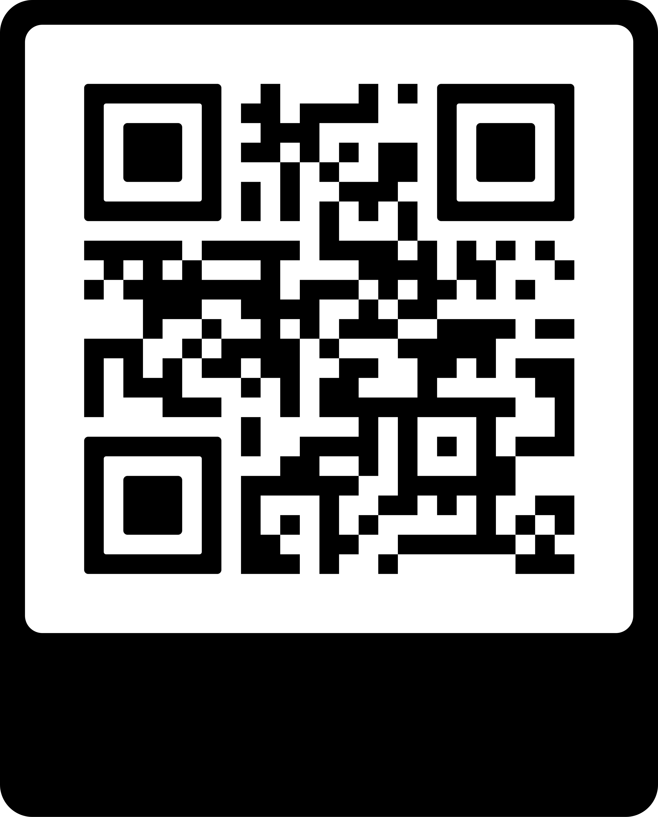
The West Group Web Page.
www.wgsm.org.uk
Notes:
All lessons can be found on the West Group Web Page. www.wgsm.org.uk.
Members section – L&D Tab.

Slide 56


Slide 57
End of Presentation
Any Questions?

